Slide 1
Chapter 14 Personality

Slide 2
Quiz

Slide 3
Defining Some Terms
Personality: A person’s unique pattern of thinking, emotion, and behavior; the consistency of who you are, have been, and will become
Character: Personal characteristics that have been judged or evaluated; desirable or undesirable qualities
Temperament: Hereditary aspects of personality, including sensitivity, moods, irritability, and distractibility

Slide 4
Some More Terms
Personality Traits: Stable qualities that a person shows in most situations
Personality Type: People who have several traits in common

Slide 5
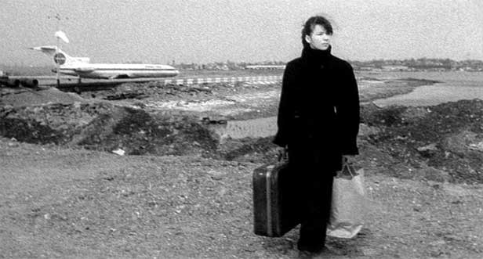
Thematic Apperception Test
What is going on in this picture?
What led up to this situation?
What’s going to happen next?

Slide 6
Themes
Analyze your partners stories for the following
patterns or themes:
Aggression
Achievement
Love
Anger
Revenge
Sex
Other prominent themes

Slide 7
Different Personality Theories
Trait theories: personality variation
Psychodynamic theories: Focus on the inner workings of personality, especially internal conflicts and struggles
Social learning Theories: attribute difference in personality to socialization, expectations and mental processes
Humanistic theories: Focus on private, subjective experience and personal growth
Behaviorist theories: ocus on external environment and on effects of conditioning and learning

Slide 8
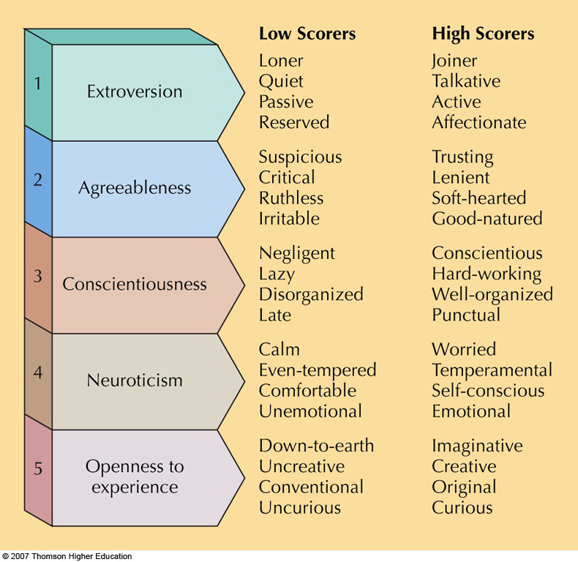
The Big Five. According to the five-factor model, basic differences in personality can be “boiled down” to the dimensions shown here.
Fig. 14-4, p. 466

Slide 9
Psychoanalytic Theory originated by Sigmund Freud, M.D.
Freud was a Viennese physician who thought his patients’ problems were more emotional than physical
Freud began his work by using hypnosis and eventually switched to psychoanalysis
Freud had many followers: Jung and Adler, to name a few
Freud used cocaine and tobacco and died from oral cancer
More than 100 years later, his work is still influential and very controversial

Slide 10
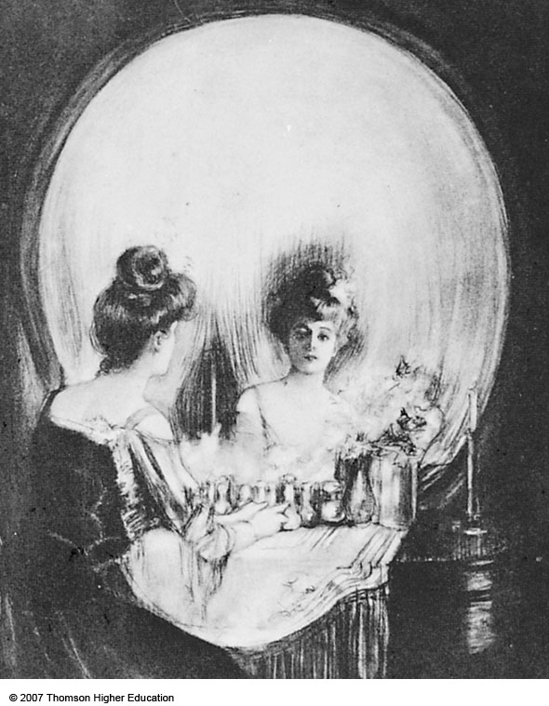
Freud considered personality an expression of two conflicting forces, life instincts and the death instinct. Both are symbolized in this drawing by Allen Gilbert.
p. 470

Slide 11
Freud’s Psychoanalytic Theory: The Id
Innate biological instincts and urges; self-serving, irrational, and totally unconscious
Works via Pleasure Principle: Wishes to have its desires (pleasurable) satisfied NOW, without waiting and regardless of the consequences

Slide 12
Freud’s Psychoanalytic Theory: The Ego
Executive; directs id energies
Partially conscious and partially unconscious
Works via Reality Principle: Delays action until it is practical and/or appropriate

Slide 13
Freud’s Psychoanalytic Theory: The Superego
Judge or censor for thoughts and actions of the ego
Superego comes from our parents or caregivers; guilt comes from the superego
Two parts
Conscience: Reflects actions for which a person has been punished
Ego Ideal: Second part of the superego; reflects behavior one’s parents approved of or rewarded

Slide 14
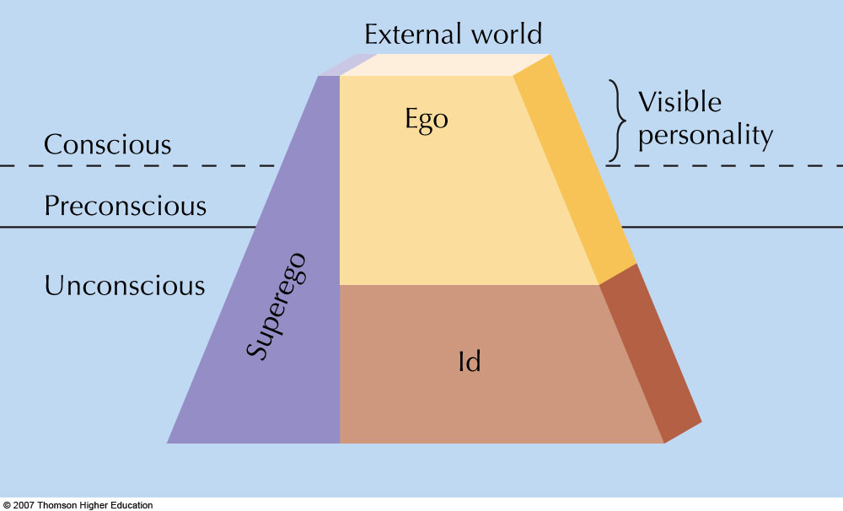
Fig. 14-6, p. 471
Notes:
Figure 14.6: The approximate relationship between the id, ego, and superego, and the levels of awareness.

Slide 15
Freudian Dynamics of Personality and Anxieties
Ego is always caught in the middle of battles between superego’s desires for moral behavior and the id’s desires for immediate gratification
Neurotic Anxiety: Caused by id impulses that the ego can barely control
Moral Anxiety: Comes from threats of punishment from the superego

Slide 16
Freud: Levels of Awareness
Unconscious: Holds repressed memories and emotions and the id’s instinctual drives
Conscious: Everything you are aware of at a given moment including thoughts, perceptions, feelings, and memories
Preconscious: Material that can easily be brought into awareness

Slide 17
Freudian Personality Development
Develops in stages; everyone goes through same stages in same order
Majority of personality is formed before age 6
Erogenous Zone: Area on body capable of producing pleasure
Fixation: Unresolved conflict or emotional hang-up caused by overindulgence or frustration

Slide 18
When was this brilliant man ever wrong?
Oedipus Conflict: For boys only. Boy feels rivalry with his father for his mother’s affection. Boy may feel threatened by father (castration anxiety). To resolve, boy must identify with his father (i.e., become more like him and adopt his heterosexual beliefs)
Elektra Complex: Girl loves her father and competes with her mother. Girl identifies with her mother more slowly because she already feels castrated

Slide 19
Freud’s Word Associations
Select one of the following words:
Mother, father, death, birth, gun, love, failure, breast, rival
Then write the FIRST word that comes to mind after selecting from the list
Then write the first word that comes to mind from THAT word you wrote
Repeat this process 10 times

Slide 20
Where did you end up?
Share where you started and where you ended up with a partner.
Explain, as much as you can, HOW you ended up with the word you did.
Does it relate to what’s going on in your life currently? With unresolved sexual trauma or development as a child? Your Oedipus or Electra complex?

Slide 21
Freud’s Disciple: Carl Jung
Persona: Mask or public self presented to others
Personal Unconscious: Individual’s own experiences are stored in here
The contents are unique to each individual
Collective Unconscious: Unconscious ideas and images shared by all humans
Archetypes: Universal idea, image, or pattern found in the collective unconscious
Origins of art therapy

Slide 22
Carl Jung’s Extroversion Test
Jung was the first to coin the term introvert vs extrovert.
What are you?
See handout 14.2
This is an example of a self reported personality test.
Is it valid? (measure what it claims)
Is it reliable? (consistent for same people)

Slide 23
Learning Theories and Some Key Terms
Behavioral Personality Theory: Model of personality that emphasizes learning and observable behavior
Learning Theorist: Believes that learning shapes our behavior and explains personality
Situational Determinants: External causes of our behaviors

Slide 24
Dollard and Miller’s Theory
Habit: Learned behavior pattern
Drive: Any stimulus strong enough to goad a person into action (like hunger)
Cue: Signals from the environment that guide responses
Response: Any behavior, either internal or observable; actions
Reward: Positive reinforcement

Slide 25
Some More Key Terms
Self-efficacy (Bandura): Belief in your capacity to produce a desired result
Social Reinforcement: Praise, attention, approval, and/or affection from others

Slide 26
Critical Childhood Situations from Learning theory
Feeding
Toilet or cleanliness training
Sex training
Learning to express anger or aggression
When done improperly, these have huge consequences for adult development

Slide 27
Humanism
Approach that focuses on human experience, problems, potentials, and ideals
Human Nature: Traits, qualities, potentials, and behavior patterns most characteristic of humans
Free Choice: Ability to choose that is NOT controlled by genetics, learning, or unconscious forces

Slide 28
Carl Rogers’ Self Theory
Fully Functioning Person: Lives in harmony with his/her deepest feelings and impulses
Self: Flexible and changing perception of one’s identity
Self-Image: Total subjective perception of your body and personality
Incongruence: Exists when there is a discrepancy between one’s experiences and self-image
Ideal Self: Idealized image of oneself (the person one would like to be)

Slide 29
All of these personality theories are derived from personality assessments
Reliability: Does a test give close to the same score each time it is given to the same person?
Validity: Does the test measure what it claims to measure?

Slide 30
Projective Tests
Psychological tests that use ambiguous or unstructured stimuli; person needs to describe the stimuli or make up stories about them
Example: TAT test, Freud’s Word Assocations

Slide 31
Rorschach Technique
Developed by Swiss psychologist Hermann Rorschach; contains 10 standardized inkblots (the “inkblot” test)

Slide 32
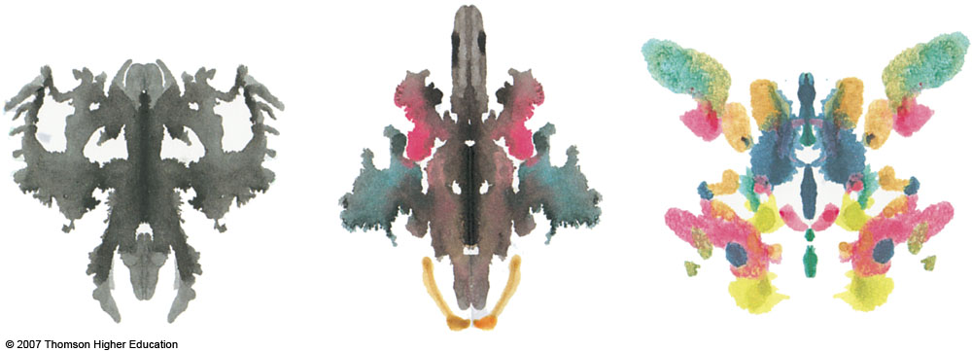
What do you see?
Fig. 14-10, p. 489
Notes:
Figure 14.10: Inkblots similar to those used on the Rorschach. What do you see?

Slide 33
IOU’s
I like ______ about psychology 202 with Ben.
______ ought to change about psychology 202.
Anonymous.

